Slide 1
Smart Shopping – Team 11
Cameron L’Ecuyer – Class ID: 17 (Team Leader)
Sneha Mishra – Class ID: 21
Navya Pillala – Class ID: 26
Ruthvic Punyamurtula – Class ID: 30

Slide 2
Application’s Purpose
Originally our app would use AR functionality to help users shop for clothing
We have switched to helping users with furniture
Current Technologies:
Android Studio
Unity
Firebase
APIs for item searching, image recognition, facial recognition, and weather

Slide 3
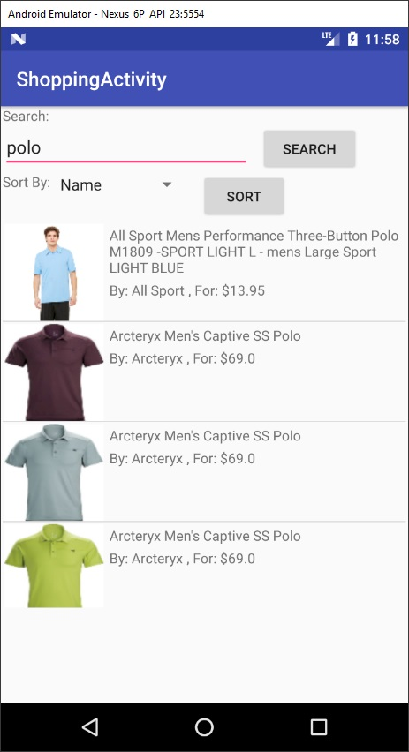
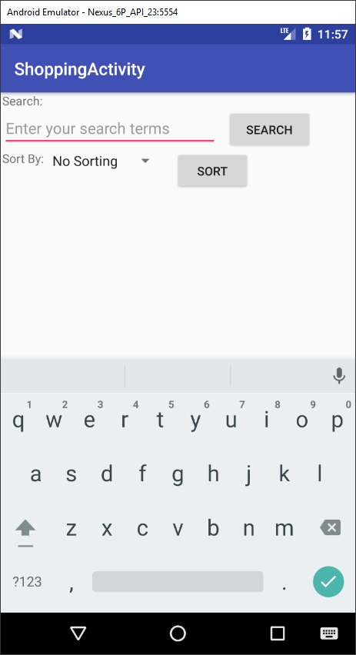
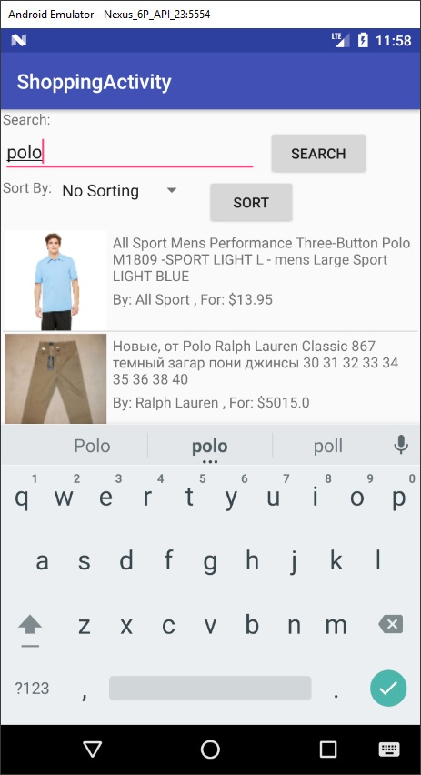
Item Searching

Slide 4

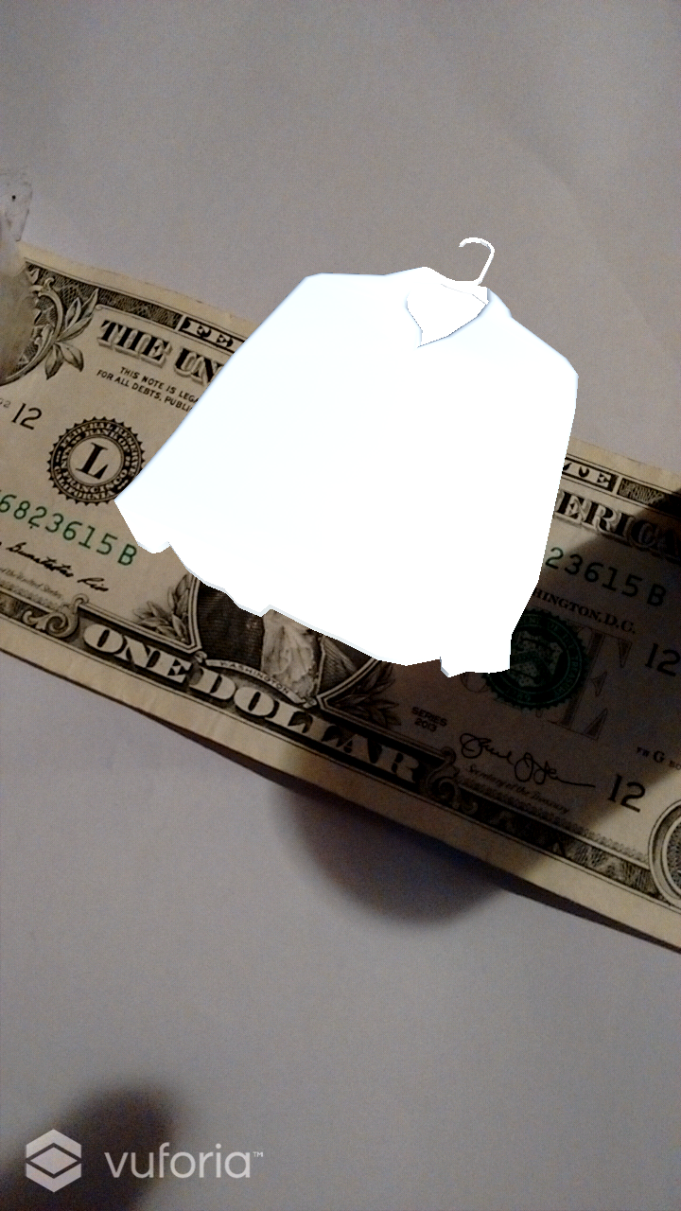
AR

Slide 5
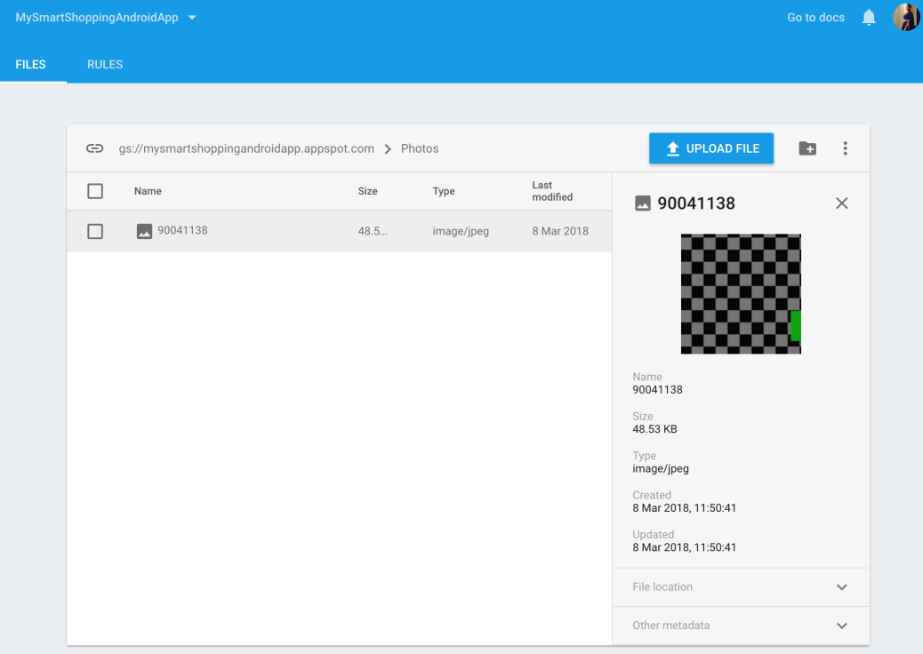
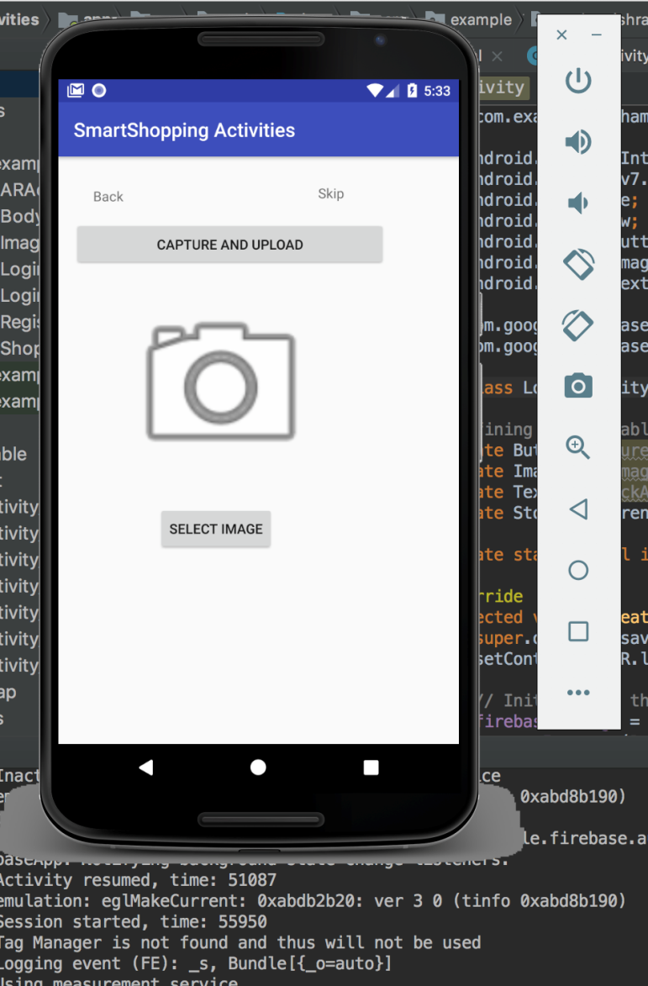
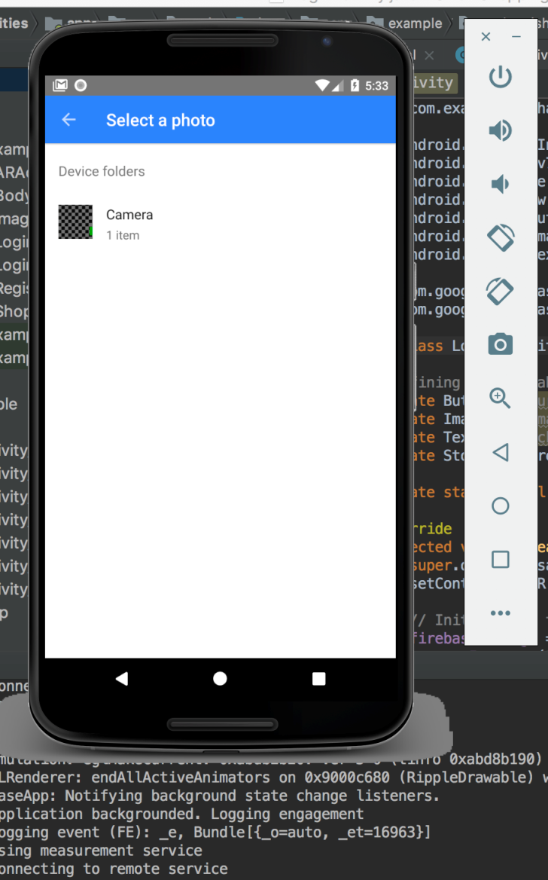
Image Recognition

Slide 6
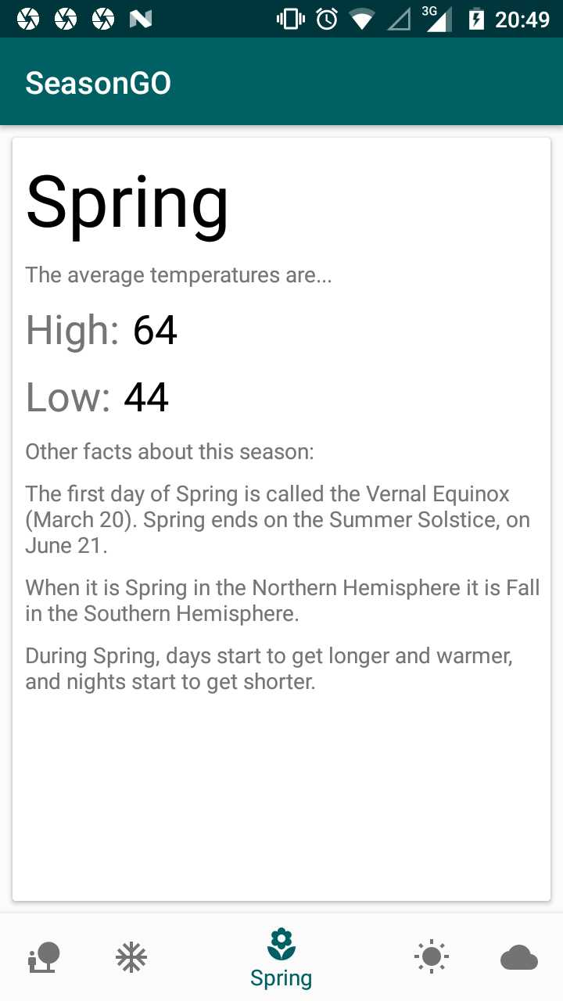
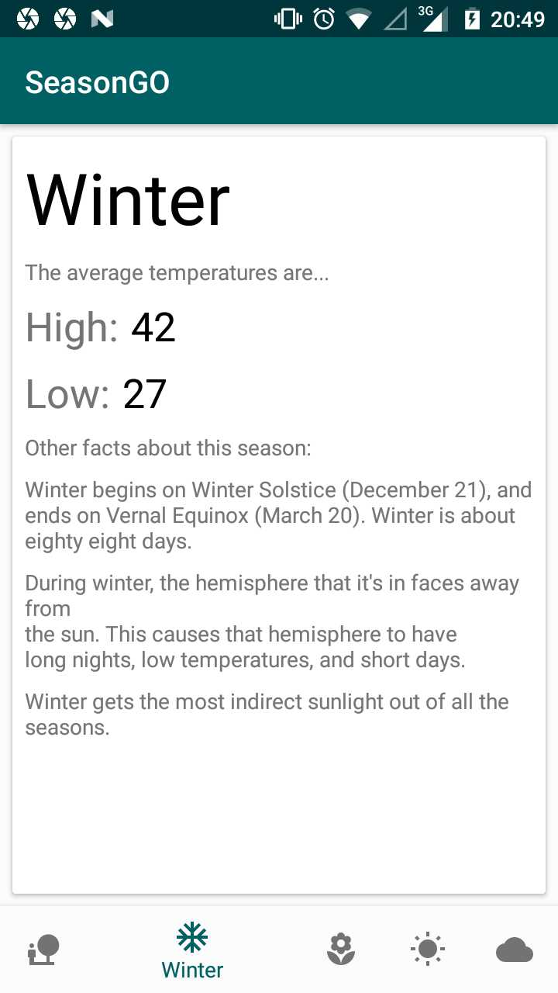
Weather

